Slide 1

ALGHERO RACE HISTORY
Elite Analysis · Past 8 Years · April 2026
USA Triathlon High Performance

Slide 2
Key Course Differentiators
Alghero
ALGHERO
COURSE AT A GLANCE
Set on Sardinia’s Coral Riviera, Alghero is a coastal Olympic-distance course built around San Giovanni Beach, the port, and the historic city centre. It is not a pure flat-power course: the bike includes some uphill/downhill sections, repeated direction changes, and enough technicality to make positioning important before the run.
Swim:
1.5 km
Bike:
40.5 km
Run:
10.0 km
Format:
Standard Triathlon
COURSE FEATURES
Bike Laps:
9 (~12 key turns/lap est.)
Run Laps:
4 (surface likely pavement)
• Beach/pontoon-style sea swim at San Giovanni Beach; 1.5 km over two laps with the first buoy ~325 m from the start.
QUICK LINKS
• 40.5 km bike over 9 laps; coastal urban circuit with some uphill/downhill sections and many direction changes.
Current Race Info:
2026 World Triathlon race info
• 10 km run over 4 laps through the centre of Alghero and along the seafront; likely pavement/urban surface.
Last Year's Results:
2025 Alghero results
• Late-May conditions can be hot and exposed: 2025 race day was ~27–28°C, humid, and wetsuit-forbidden.
Race Replay:
TriathlonLIVE replays + WT highlights

Slide 3
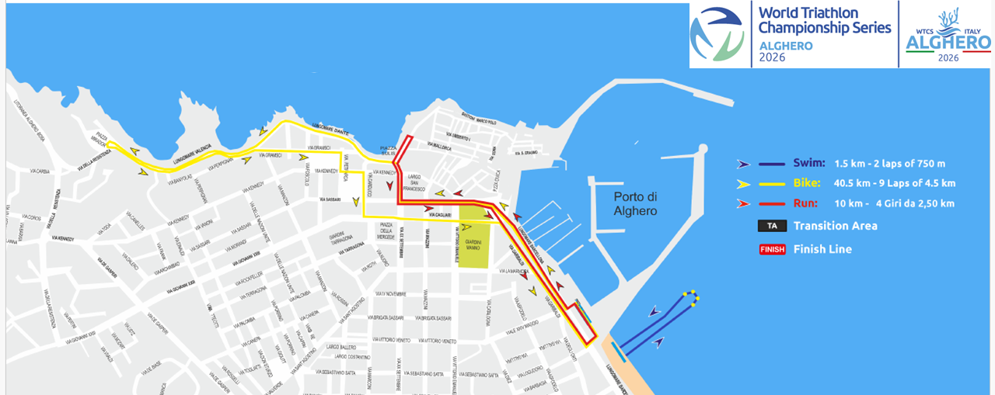
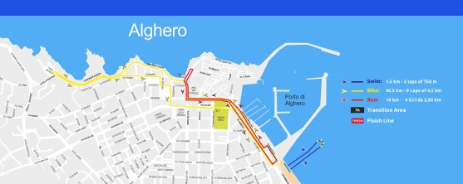
Course Profile & Map
Alghero
2026 Course
2025 Course
Source: 2026 World Triathlon race info / course map
Source: 2025 World Triathlon race info / Field of Play map
Discipline | Distance | Laps | Terrain / Notes
Swim | 1.5 km | 2 | Sea swim at San Giovanni Beach; first buoy ~325m; beach start with water-start contingency.
Bike | 40.5 km | 9 | Urban coastal circuit with some uphill/downhill sections and numerous changes of direction.
Run | 10.0 km | 4 | City-centre + seafront run; likely paved urban surface.

Slide 4
Environmental Risk Profile
Alghero
RACE-DAY WEATHER (08:00–11:00 local)
AIR QUALITY (Open-Meteo archive)
Year | Date | Air Temp | Humidity | Wind km/h | Precip mm
2025 | May 31 | 27 | 72% | 9 | 0.0
Year | PM2.5 | EU AQI | UV Index | Risk
2025 | 6.0 | 30 | 3.4 | Fair
HEALTH & WATER QUALITY RISK FACTORS
• Water Quality: Low to No Risk. 2026 athlete guide reports San Giovanni test values well below limits: E. coli 44–51 CFU/100ml vs 500 limit; fecal enterococci 14–25 CFU/100ml vs 200 limit.
• Athlete Health / GI Risk: Low to No Risk. No public Alghero race-week illness cluster or swim cancellation found.
• Water Temperature: Borderline. Likely non-wetsuit. 2025 race measured ~21.8–22.0°C and was wetsuit-forbidden. Athlete guide lists late-May San Giovanni range at ~15.5–21°C, so 2026 could still be borderline depending on week-of weather.
• Heat / Humidity: Moderate Heat. 2025 was warm for WTCS racing: ~27–28°C air temp with ~72% humidity. Women race at 11:00; men at 14:00, so heat load and cooling/hydration are factors to consider given the Olympic distance.
Weather/AQ data: Open-Meteo historical archive; water-quality + water-temp context: 2026 athlete guide and World Triathlon results. Air quality in 2025 was fair (PM2.5 ~6.0; EU AQI ~30).

Slide 5
Travel & Arrival Load
Denver, CO → Alghero race week
Denver to Alghero Travel
No direct AHO service from DEN, likely 1–2 stops through a major European hub and Rome/Milan. Roughly ~20h hour travel door-to-door. 8 hour time-zone change. Non-EU and Schengen Area citizens require an invitation letter and declaration from the National Federation for participation at the event.
Primary route
Flight time
Time zones
AHO transfer
Backup airports
DEN to Europe to AHO
~21h
+8h
10 km (Sign up by May 8th)
Olbia / Porto Torres
Likely 1–2 stops
example 1-stop itinerary
Alghero ahead of Denver
LOC shuttle available
138 km / 35 km from town
Host Hotel / Official Accommodation Read
Food / Grocery Options Near Hotel + Venue
• Official host hotel: Hotel Calabona, Località Calabona; 4-star seaside property listed by WTCS travel page.
• Logistics read: outside the port/transition area but close enough for LOC shuttle support; hotel is roughly a 15-min walk from Alghero’s historic centre.
• Quality read: strong sea-view/pool/private-beach profile; reviews generally note clean rooms and good breakfast, but some describe the hotel as a little dated/rustic.
• Price read: public OTA snapshots vary; recent examples cluster around ~$85–120/night before race-week demand.
• Athlete note: good base if the team uses official transport; plan one grocery stock-up because immediate supermarket access is not as dense as Yokohama.
• Best stock-up targets: Conad / Coop / Eurospin in Alghero for fruit, yogurt, rice/pasta, breakfast staples, drinks, and room food.
• Quick hotel-side options: expect smaller local markets and cafés near Calabona; larger selection is easier closer to town / Lido.
• Restaurant read: old town + waterfront have many options; near Calabona, Quintilio / La Saletta style seafood and simple Italian options are close.
• Food risk: Low. Sardinia/Alghero is very traveler-friendly with strong reviews
Sources: WTCS 2026 Alghero travel page/athlete guide; Hotel Calabona official site; Booking/Expedia/Hotels.com/Tripadvisor review summaries; local Alghero supermarket/restaurant listings.

Slide 6
ELITE MEN

Slide 7
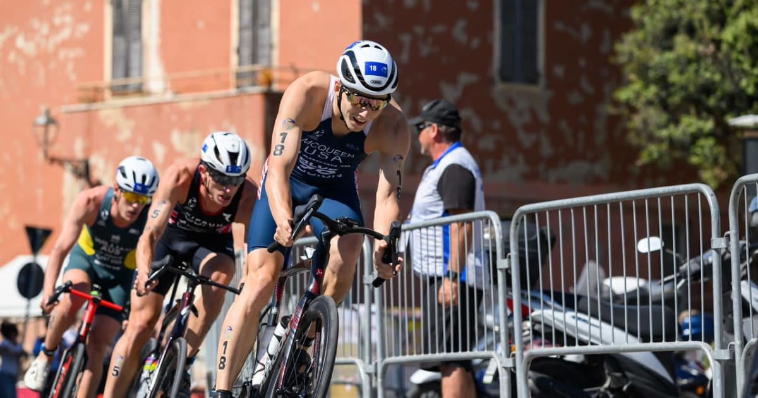
Race Overview — Elite Men
Alghero
RACE HISTORY AT ALGHERO
3 KEYS TO SUCCESS
Alghero debuted on the WTCS calendar in 2025 and immediately offered a hard race that results in 10 DNF/LAPs in a field of 43 athletes. A small group of 20 came out of T1, but a hard bike punctuated by significant hill allowed an exclusive of 8 to open a 103s gap to the chase. Hidalgo ultimately went on to win with a 30:05.
1
Swim positioning is paramount. There were no major breaks on the swim but the athletes towards the front of the spear were able to get the work on bike and separate quickly.
2
Aggressive and controlled bike handling. 10 athletes race came to an early finish on the bike leg. Expect to be on the rivet through rolling climbs and be aware of crash potential.
3
Expect a hard and hilly but not overly fast run. Only one athlete managed to break
All stats only include athletes that finished the race

Slide 8
Results Summary — Elite Men
Alghero
Year | Date | Category | Field | Winner | Winner Time | Air Temp | Water Temp | Swim km | Bike km | Run km
2025 | May 31 | World Championship Series | 43 | Hidalgo | 1:44:05 | 27 | 22 | 1.50 | 40.5 | 10.0

Slide 9
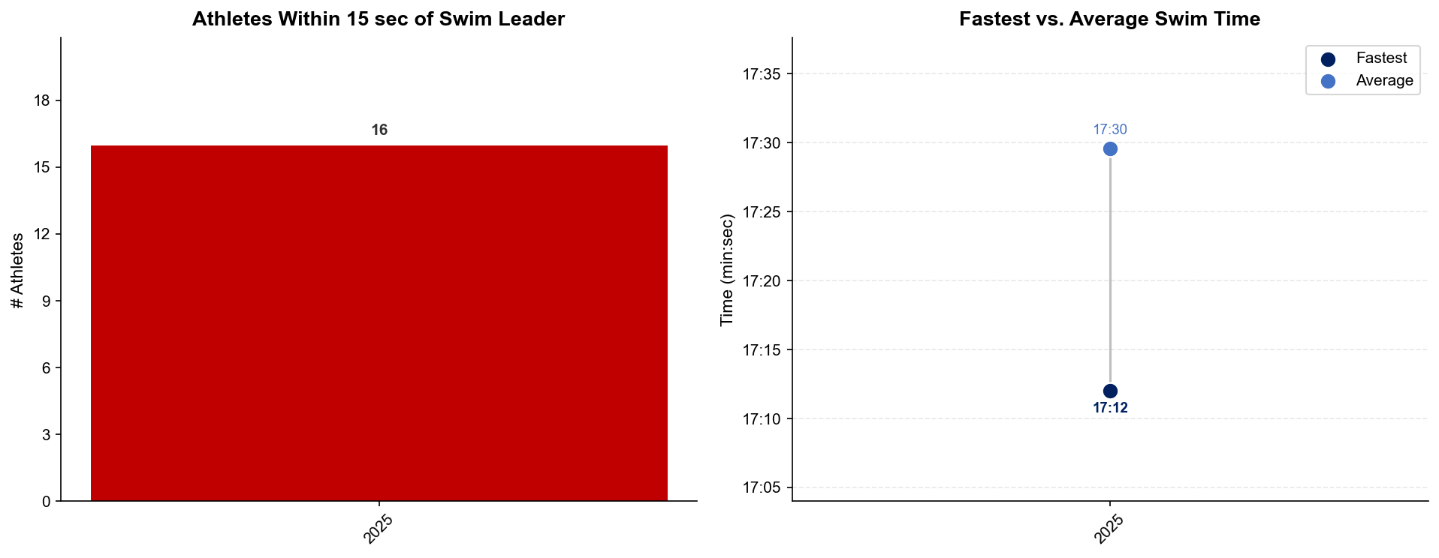
Swim Exit Dynamics — Elite Men
Alghero
All stats only include athletes that finished the race

Slide 10
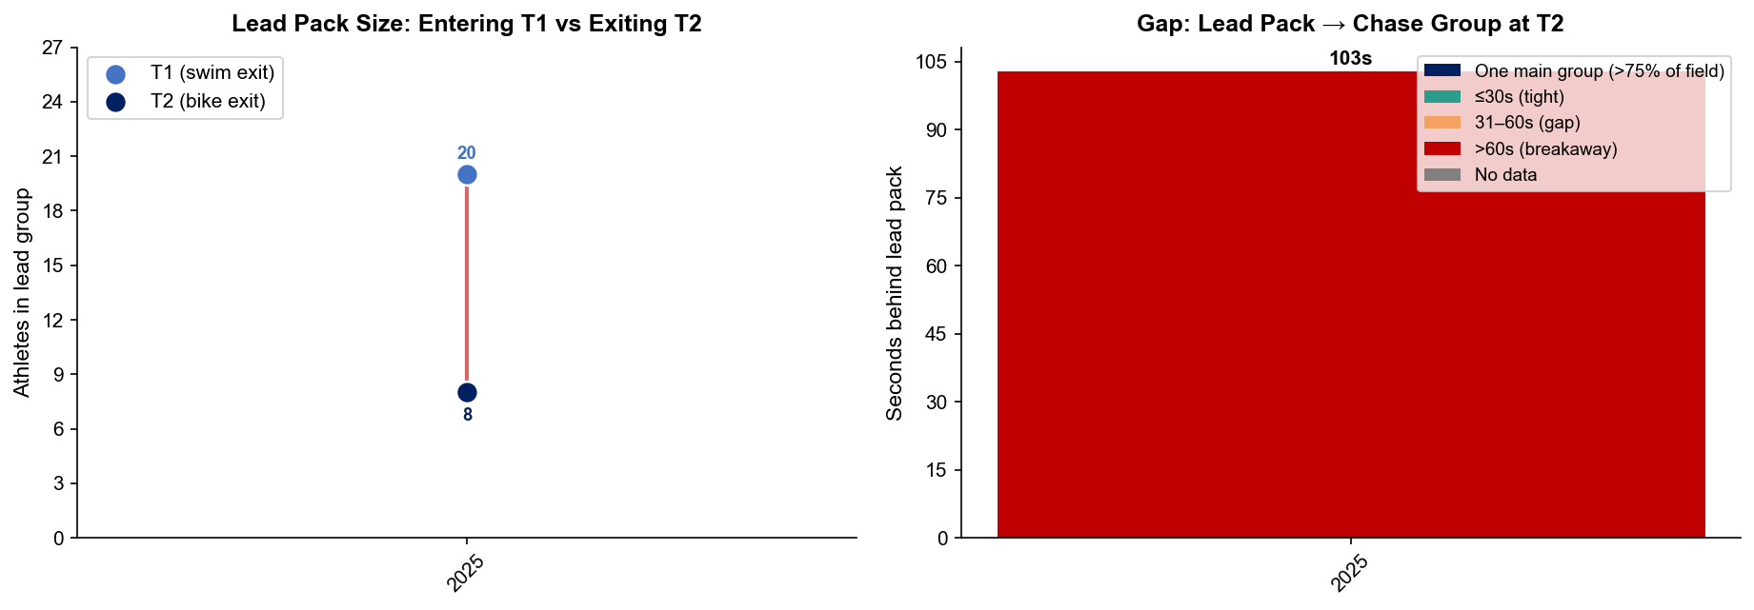
Bike Pack Evolution — Elite Men
Alghero
Lead pack = athletes within 15 sec of leader. T1 = lead group entering the bike; T2 = lead group exiting the bike.
Year | Lead Size @ T1 | Lead Size @ T2 | Change | Chase Group @ T2 | Chase Gap*
2025 | 20 | 8 | -12 | 24 | 103s
Lead pack = athletes within 15 sec of leader. Chase group = athletes within 15 sec of the first athlete outside the lead pack. * Chase Gap = seconds from the last lead-pack athlete to the first chase-group athlete at T2. Only includes athletes that finished

Slide 11
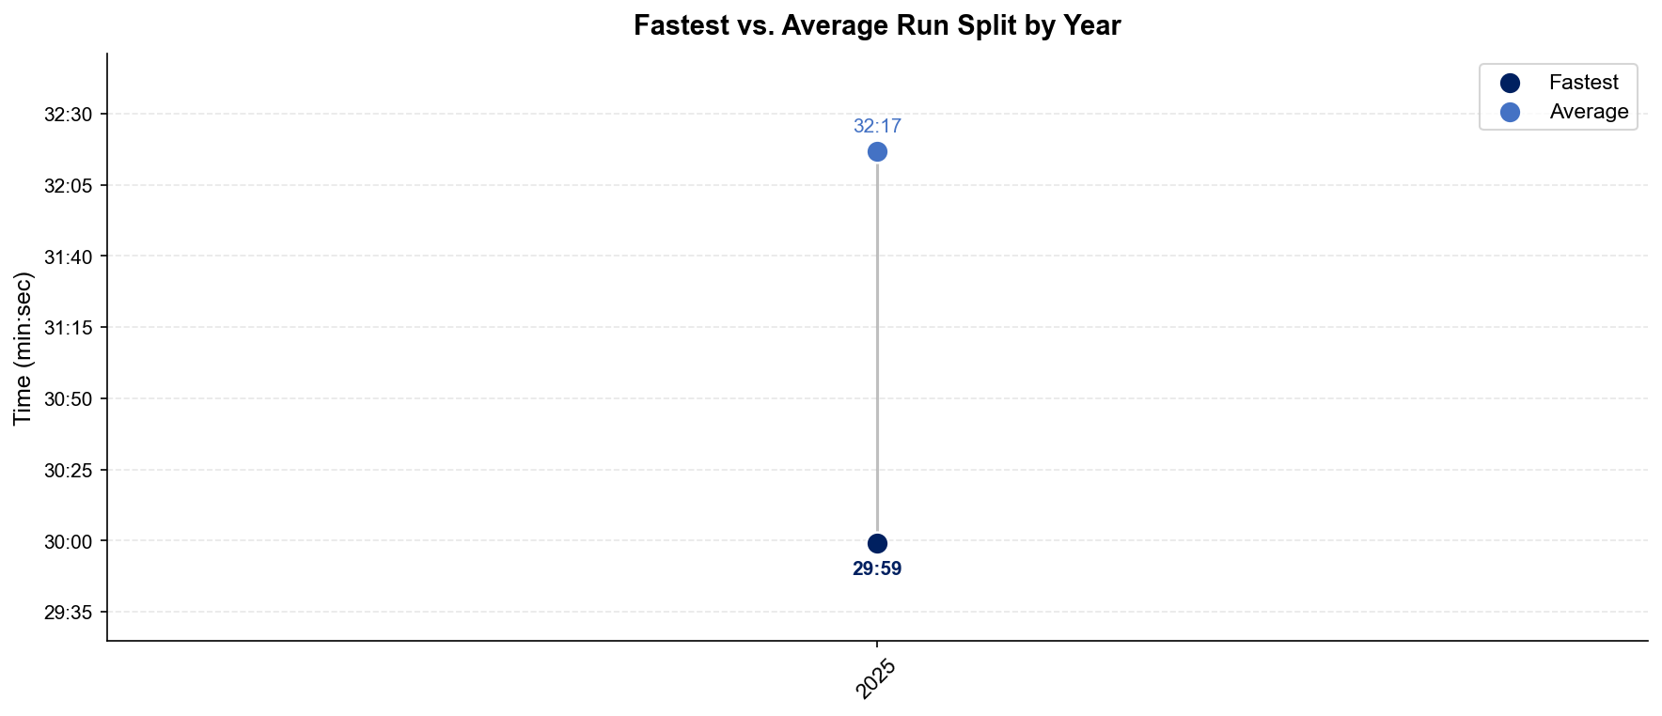
Run Split Analysis — Elite Men
Alghero
All stats only include athletes that finished the race

Slide 12
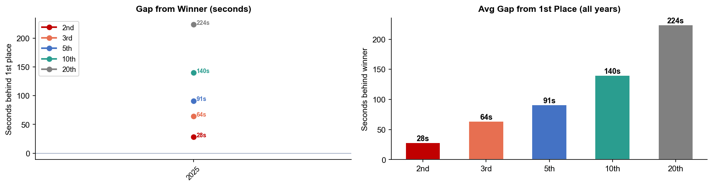
Key Position Times — Elite Men
Alghero
Year | 1st | 2nd | 3rd | 5th | 10th | 20th
2025 | 1:44:05 | 1:44:33 +28s | 1:45:09 +64s | 1:45:36 +91s | 1:46:25 +140s | 1:47:49 +224s
All stats only include athletes that finished the race

Slide 13
Race Conditions — Elite Men
Alghero
Year | Date | Air Temp | Humidity | Wind (km/h) | Precip (mm) | Water Temp | Wetsuit | Conditions
2025 | May 31 | 27 | 72% | 9 | 0.0 | 22 | forbidden | —
Air temp, humidity, wind, and precipitation sourced from Open-Meteo historical archive (race window 08:00–11:00 local) where WT API data is absent. Values marked * are Open-Meteo estimates. Water temp and wetsuit ruling are from the World Triathlon API per program.

Slide 14
ELITE WOMEN

Slide 15
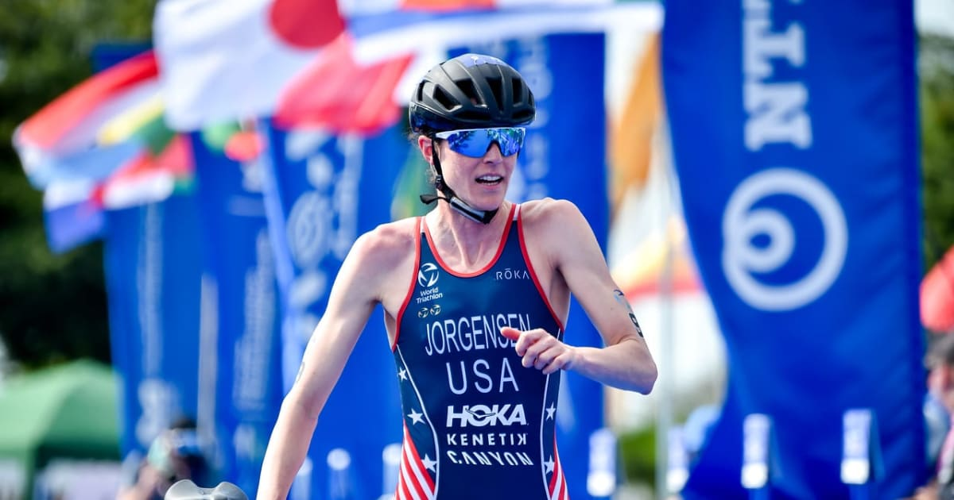
Race Overview — Elite Women
Alghero
RACE HISTORY AT ALGHERO
3 KEYS TO SUCCESS
Alghero’s first WTCS women’s race was more selective than the men’s race from the start. Only 7 athletes were in the lead group at T1 and 6 remained at T2, with a 142s gap to the chase. Beaugrand won from the front group, reinforcing that this course can reward a true swim-bike selection before the run begins.
1
Fast swimming can set up for a top 15 finish here. Only 2 women that missed the front swimmers were able to finish in the top 10.
2
Missing the front bike group here meant missing the podium but not the top 5-10 spots. Despite a two-minute deficit, Leonie Perialt managed to catch two of the leaders and run into 5th.
3
Prepare for a sub-35-minute 10k here. In 2025 5 women including the winner ran under the threshold.
All stats only include athletes that finished the race

Slide 16
Results Summary — Elite Women
Alghero
Year | Date | Category | Field | Winner | Winner Time | Air Temp | Water Temp | Swim km | Bike km | Run km
2025 | May 31 | World Championship Series | 39 | Beaugrand | 1:55:55 | 28 | 21.8 | 1.50 | 40.5 | 10.0

Slide 17
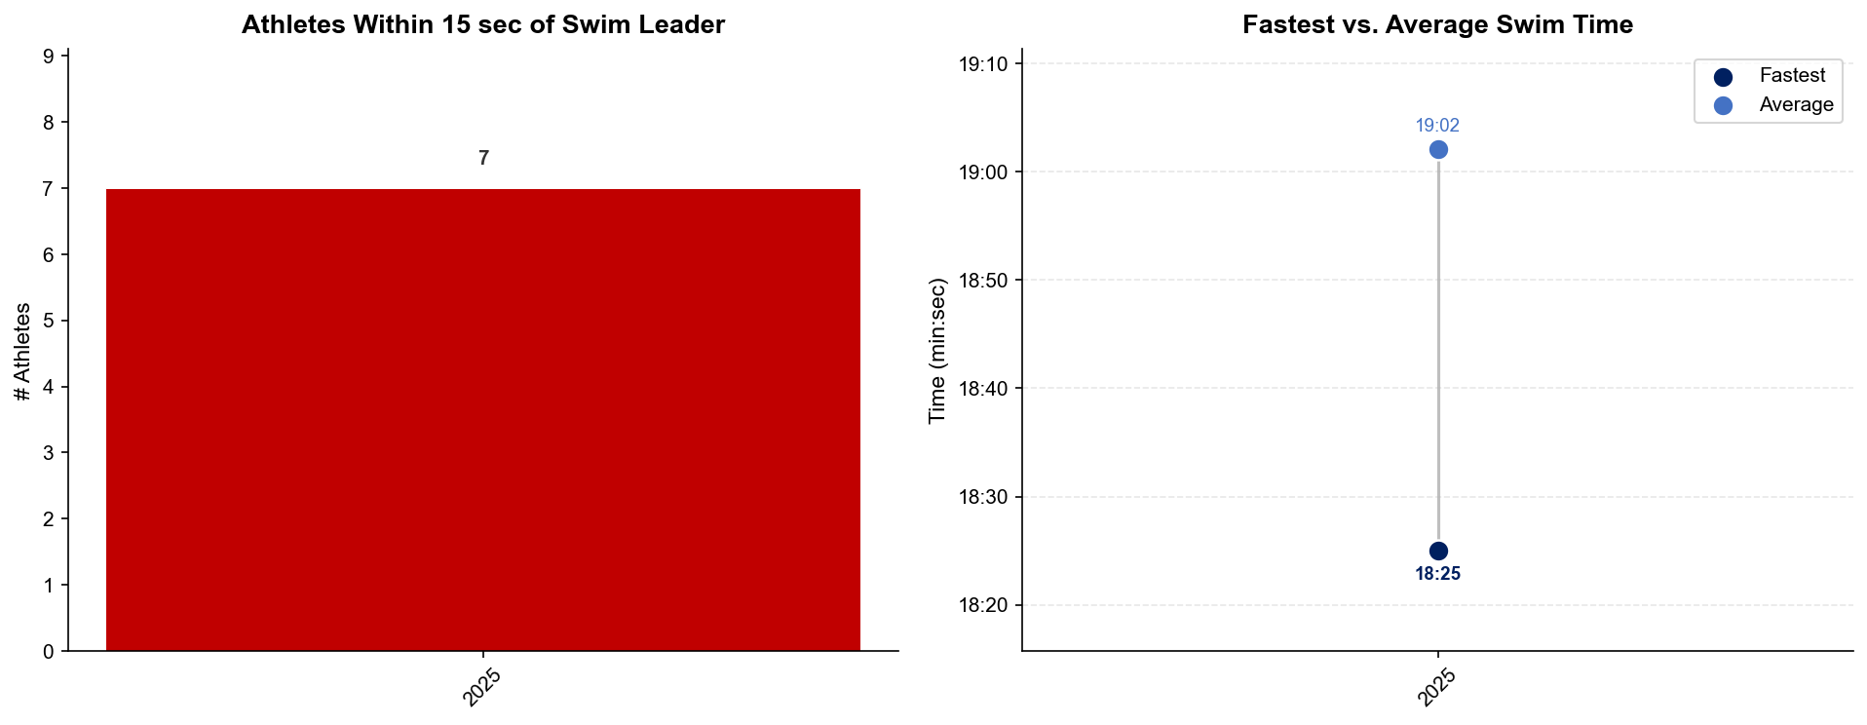
Swim Exit Dynamics — Elite Women
Alghero
All stats only include athletes that finished the race

Slide 18
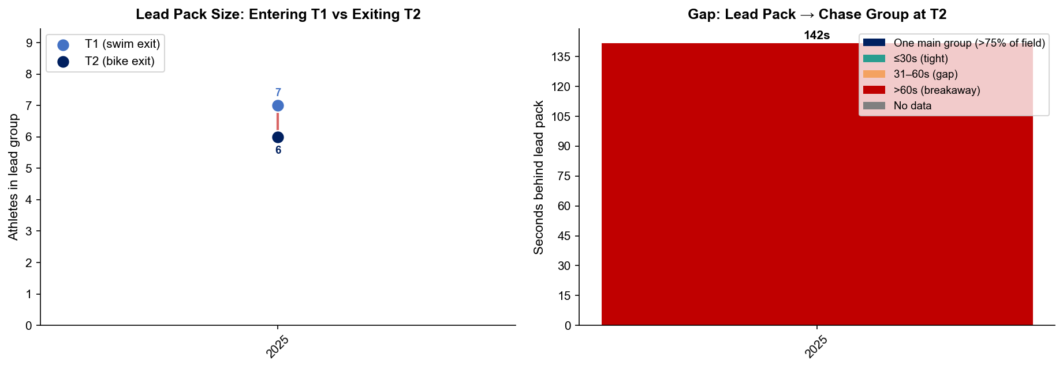
Bike Pack Evolution — Elite Women
Alghero
Lead pack = athletes within 15 sec of leader. T1 = lead group entering the bike; T2 = lead group exiting the bike.
Year | Lead Size @ T1 | Lead Size @ T2 | Change | Chase Group @ T2 | Chase Gap*
2025 | 7 | 6 | -1 | 21 | 142s
Lead pack = athletes within 15 sec of leader. Chase group = athletes within 15 sec of the first athlete outside the lead pack. * Chase Gap = seconds from the last lead-pack athlete to the first chase-group athlete at T2. Only includes athletes that finished

Slide 19
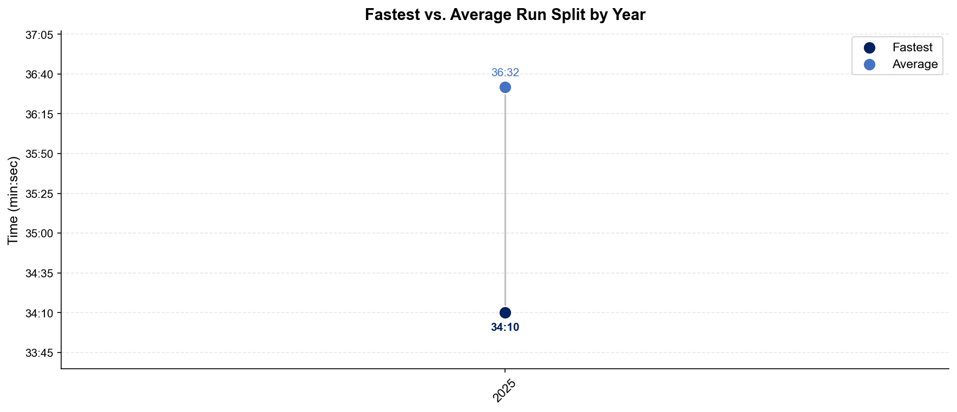
Run Split Analysis — Elite Women
Alghero
All stats only include athletes that finished the race

Slide 20
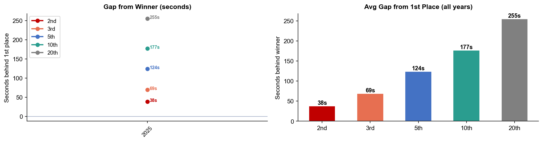
Key Position Times — Elite Women
Alghero
Year | 1st | 2nd | 3rd | 5th | 10th | 20th
2025 | 1:55:55 | 1:56:33 +38s | 1:57:04 +69s | 1:57:59 +124s | 1:58:52 +177s | 2:00:10 +255s
All stats only include athletes that finished the race

Slide 21
Race Conditions — Elite Women
Alghero
Year | Date | Air Temp | Humidity | Wind (km/h) | Precip (mm) | Water Temp | Wetsuit | Conditions
2025 | May 31 | 28 | 72% | 9 | 0.0 | 21.8 | forbidden | —
Air temp, humidity, wind, and precipitation sourced from Open-Meteo historical archive (race window 08:00–11:00 local) where WT API data is absent. Values marked * are Open-Meteo estimates. Water temp and wetsuit ruling are from the World Triathlon API per program.

